Slide 1
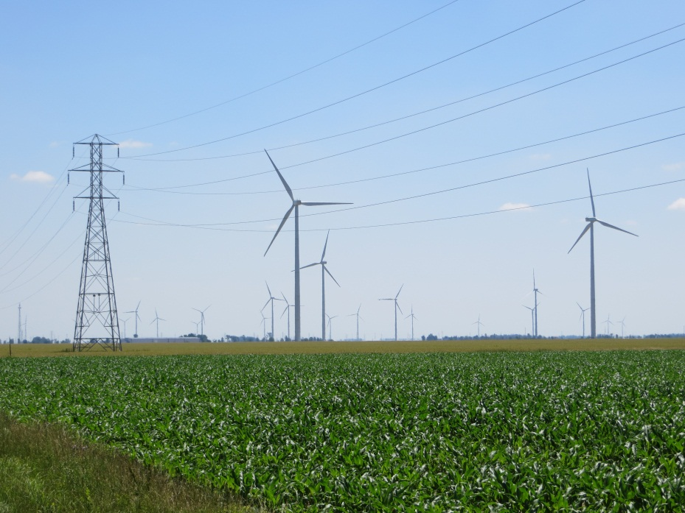

Slide 2
Disclaimer
The views expressed in this presentation are solely those of the presenter, and do not represent the views of the Ohio Power Siting Board.

Slide 3
Voting members
Non-voting members

Slide 4
What is the OPSB’s role?
Before any entity can construct a “major utility facility,” the OPSB must review the plans for the proposed facility through a formal public process
Issues a certificate for the construction, operation, and maintenance of each facility
Monitors construction and operation, to assure that it is conducted in compliance with the certificate

Slide 5
Why is this important?
Sole siting jurisdiction for major utility facilities:
public and local government participation is strongly encouraged, but decision making authority rests with the OPSB
Regulatory certainty:
process is known and understood by applicants and other parties
Timely action:
6 to 12 months for more significant projects months
Accelerated 90 day review is available for many projects
Expedited 21 to 28 day review may be possible

Slide 6
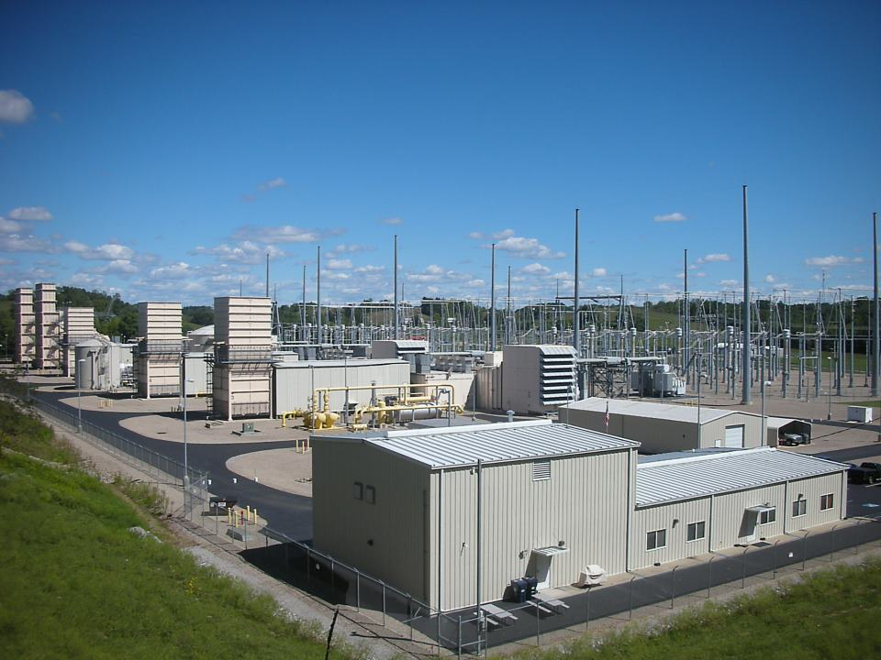
Board Jurisdiction
Electric Generation Facilities
50 megawatts and greater
(natural gas, solar, coal)

Slide 7
Wind Farms
5 MW and greater
Excludes any facility under 20 MW that is dedicated to a single customer at a single location

Slide 8
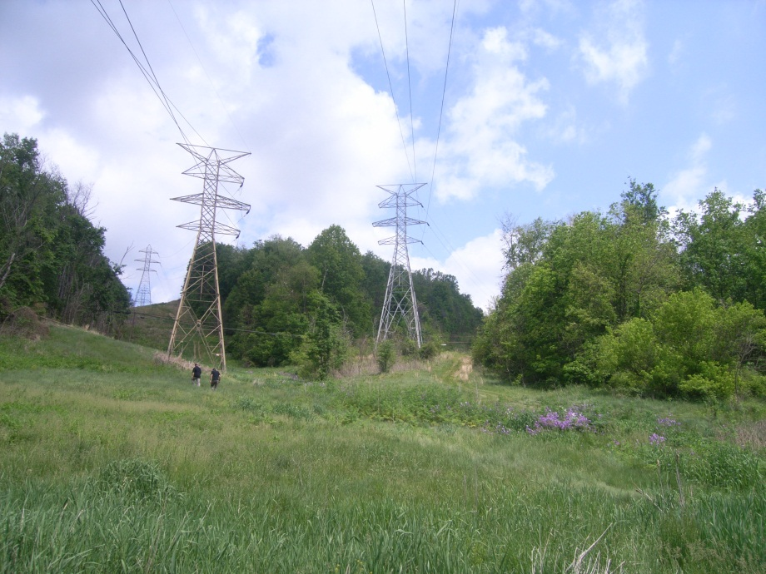
Electric Transmission
Intrastate only
100 kV or greater
Includes transmission voltage substations

Slide 9
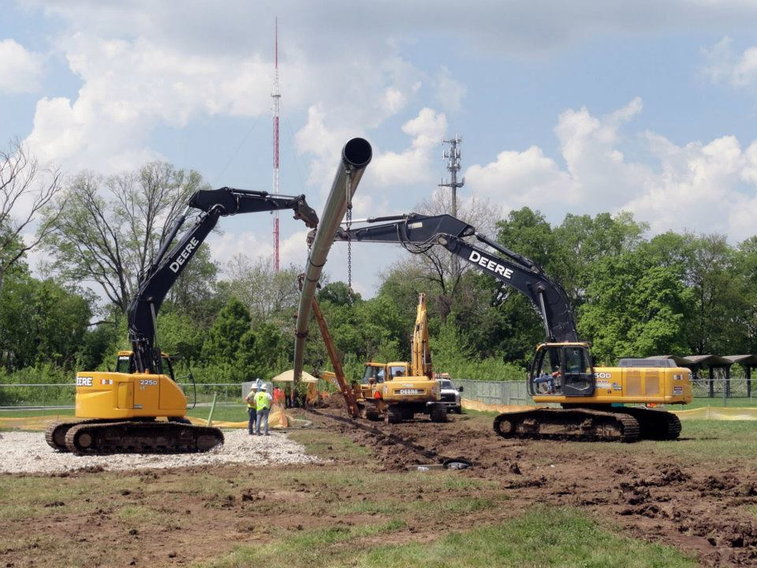
Gas Pipelines
Intrastate only
Greater than 500 feet in length and 9 inches in diameter
Maximum Allowable Operating Pressure of greater than 125 psi
No jurisdiction over production lines, gathering, or liquid lines

Slide 10
Statutes
Chapter 4906, Ohio Revised Code
4906.02, OPSB organization
4906.04, certificate required for major utility facility
4906.06, general certificate application process
4906.07, public hearing requirement
4906.10, basis for decision (8 statutory requirements)
4906.11, decision rendered through written opinion
4906.13, supersedes local jurisdiction
4906.201, setback requirements for wind facilities
4906.98, certificate required to construct
4906.99, penalty for violation

Slide 11
Rules
Chapter 4906, Ohio Administrative Code
4906-2, procedures to follow before the OPSB
4906-3, procedures for filing a standard application
4906-4, filing requirements for electric generation
4906-5, filing requirements for electric transmission and gas pipelines
4906-6, accelerated certificate applications
4906-7, enforcement investigations and forfeitures

Slide 12
Standard Application
Includes a compliance or completeness review
Requires alternative routes for transmission lines
Includes requirements for more detailed information than accelerated processes
Has mandatory public and adjudicatory hearings
Requires a written Board decision

Slide 13
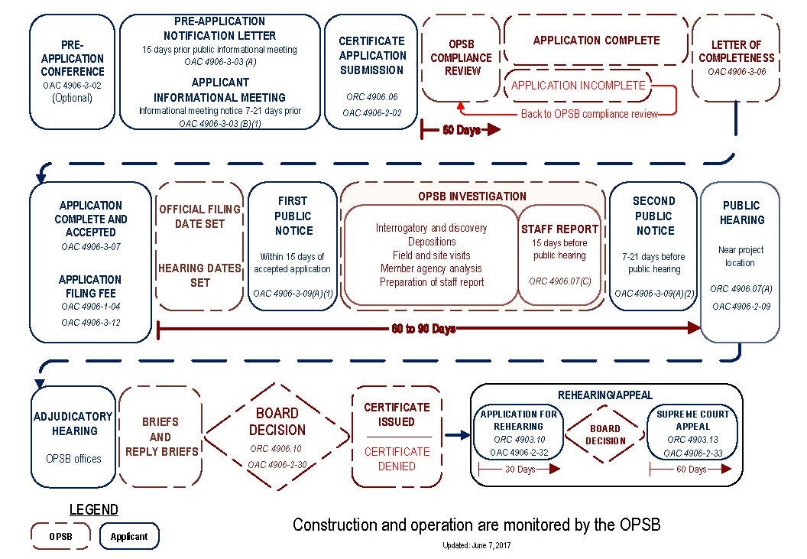
Standard Application Process

Slide 14
Public Informational Meeting
Before filing an application to build a new facility, the developer is required to hold a public informational meeting.
The purpose of this meeting is for company representatives to inform stakeholders about plans to file an application with the OPSB.
The meeting also serves as an opportunity to gather input and hear the public’s concerns, which the company considers in developing its application.
OPSB representatives are on-hand to discuss the siting process and public participation.

Slide 15
Application Submitted

Slide 16
Compliance Review
The Board’s staff reviews the application to determine if the application includes all required information and complies with the Board’s filing requirements in OAC chapter 4906.
If found to comply, the application is deemed complete.
A letter is sent to the Applicant, notifying them that the application was deemed complete. This letter also serves as an invoice for the required deposit.
The amount of deposit required is based on the size or cost of the project and is outlined in the administrative code.
If deemed incomplete, the applicant is notified of the inadequacies so that it may supplement the application with the necessary information.

Slide 17
Investigation - Eight Statutory Criteria
The probable environmental impact
Whether the facility represents the minimum adverse environmental impact, considering available technology and the nature and economics of alternatives
The need for any electric transmission or gas pipeline facility*
The facility’s consistency with regional plans for the expansion of the electric power grid of the electric systems serving Ohio and interconnected systems and that the facility will serve the interest of electric system economy and reliability
That the facility will comply with all air and water pollution and solid waste disposal laws and regulations
That the facility will serve the public interest, convenience, and necessity
The facility’s impact on the continued viability of any land in an existing agricultural district
The facility incorporates maximum feasible water conservation practices
*Need is not applicable for electric generation facilities

Slide 18
Minimum Adverse Environmental Impact
Applicant must provide baseline information concerning ecological and social issues and a description of steps taken to avoid and minimize adverse environmental impacts.
Recognizing that some impacts are unavoidable, the applicant must also describe efforts to mitigate the potential impacts to the extent feasible.

Slide 19
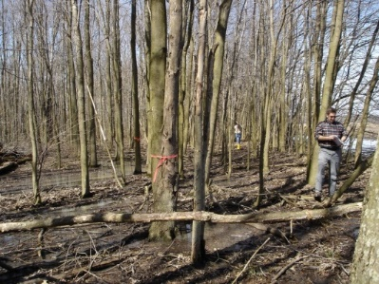
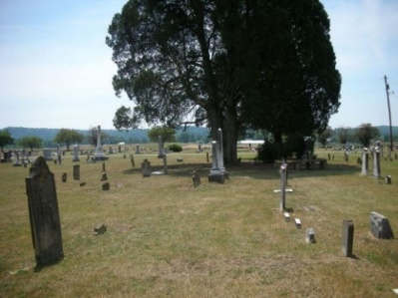
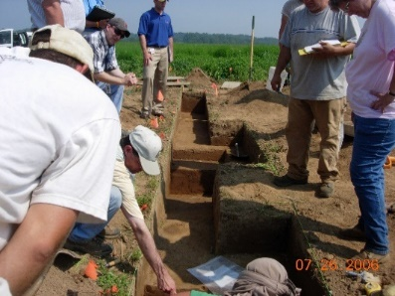
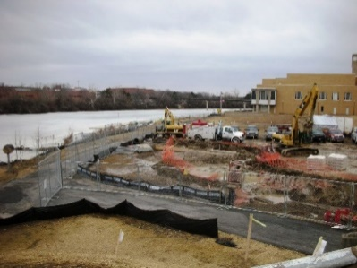
Environmental Impacts
Wetlands, Streams, Wildlife, Habitats, Cultural Resources, Sensitive Land Uses,
Socio-economic impacts, Aesthetics, Public Services, Roads, Communication,…
Types of resources present in the project area
Numbers and qualities of potentially impacted resources
Methods proposed to minimize impacts

Slide 20
Staff Report Issued

Slide 21
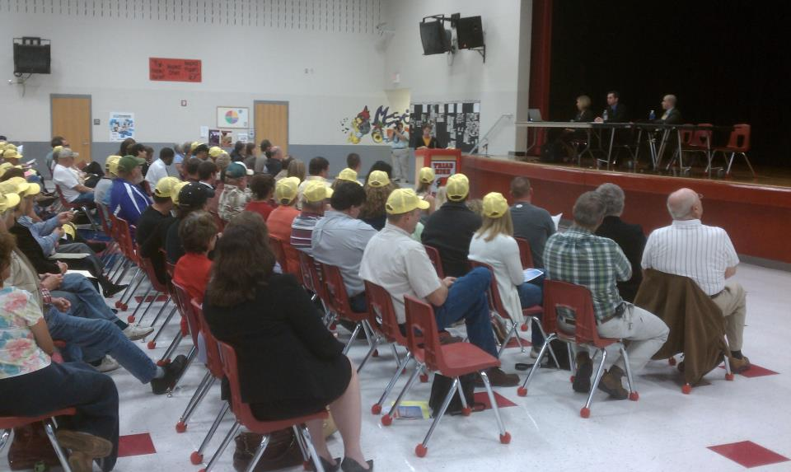
Public Hearing
The Board holds a public hearing near the project area to take sworn testimony from individuals. The hearing transcript is docketed in the case record.

Slide 22
Intervention and Adjudicatory Hearing
Formal intervention grants individuals, organizations, and local governments the right to participate as a party of record in the case proceedings.
Interveners are served with all documents in the case and may participate in the adjudicatory hearing.
The adjudicatory hearing is held to allow parties to the case to provide sworn pre-filed testimony and cross examine witnesses.
Interveners may file for rehearing and subsequently appeal a Board decision to the Supreme Court of Ohio.

Slide 23
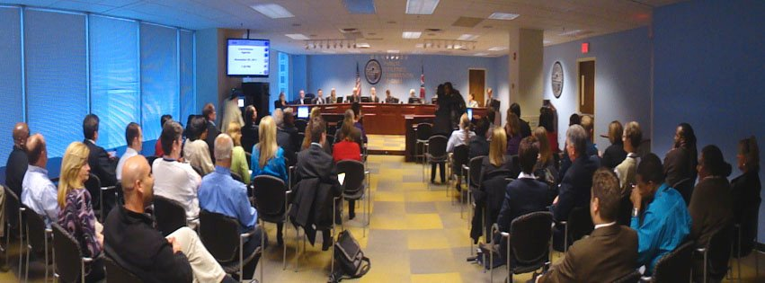
Board Decision
Board formally rules on project, issuing or denying an application for a certificate
Certificates are typically conditioned

Slide 24
Post-Certificate Activities
Preconstruction meeting
Condition deliverables
Construction monitoring by Board staff
Notifications regarding the facility’s status
Post-construction monitoring by Board staff, to assure appropriate reclamation is completed

Slide 25
Accelerated Cases
Typically smaller projects – shorter pipelines and electric lines, electric substations, generating plant on existing industrial site, etc.
May be larger pipeline or electric line projects, if for a specific customer or customers
Staff Report circulated to Board by e-mail one week prior to auto approval date (also filed in docket)
Project becomes automatically approved in 90 days, unless suspended by the Board, executive director, or administrative law judge
Earlier auto-approval possible, for good cause shown

Slide 26
Expedited Accelerated Cases
Same auto approval process as accelerated cases, but on a much faster timeline
28 days for –BLN cases, 21 days for –BNR cases
Requires a $2,000 fee for expedited treatment
Expedited treatment may be denied
Earlier auto-approval possible, for good cause shown

Slide 27
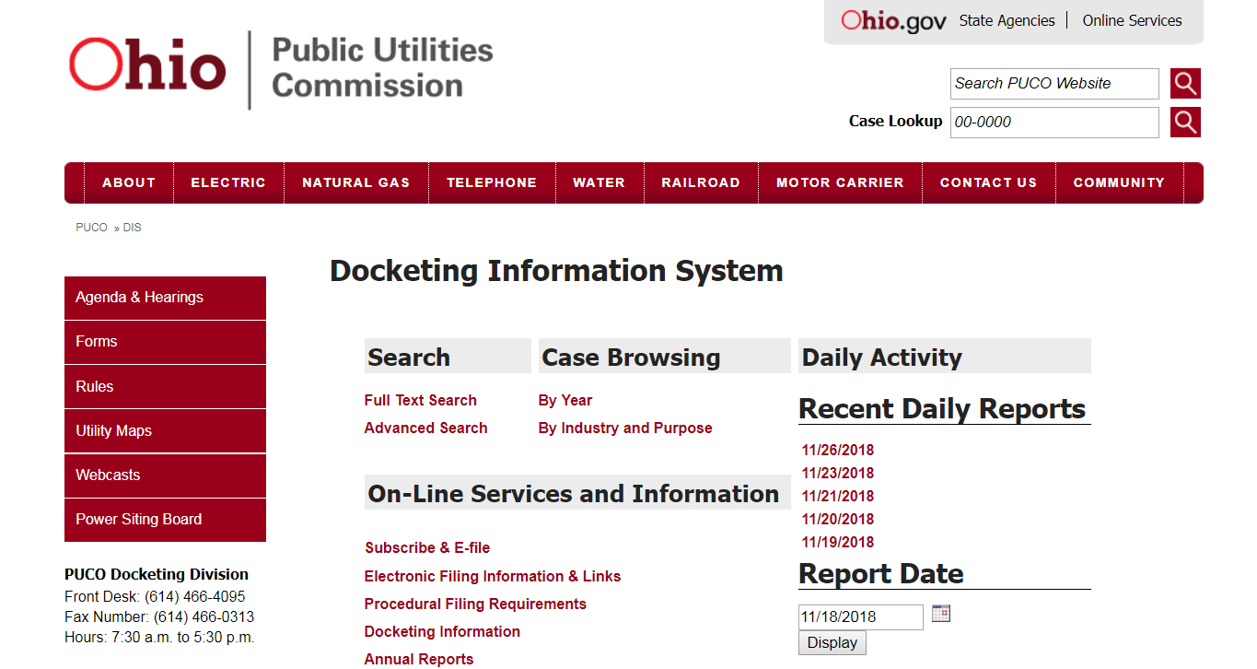
Case Docketing System
OPSB makes use of the PUCO case docketing system
Available at http://dis.puc.state.oh.us/
Every case is tracked by a case number
Every document filed in a case is available for review
The public can file comments in the case docket

Slide 28
Docketing (DIS) – Case Search Page

Slide 29
Example Case Record Page

Slide 30
Summary and Contact Info
Seven member (plus four legislative reps) agency
Only entity to approve major utility facilities
Supersedes local jurisdiction
Eight statutory criteria
Formal adjudicatory process with public involvement
By phone: 866-270-OPSB (6772)
By e-mail: ContactTheOPSB@puc.state.oh.us
By mail: 180 East Broad Street
Columbus, Ohio 43215

