Slide 1

Notary Modernization Act
Allison DeSantis
Director of Business Services and Deputy Assistant Secretary of State

Slide 2

Previous Law in Ohio
Role of the Ohio Secretary of State
Role of Ohio’s 88 counties
Issues to be Addressed by the new law
  Uniformity
  Education
  Permitting Electronic and Online Notarial Acts

Slide 3
Modernizing the Process
Legislative goals:
Standardize the notary commission process
Centralize the process to the Secretary of State’s Office
Permit electronic and online notarization

Slide 4
Senate Bill 263
Senate Bill 263, the Notary Public Modernization Act was passed in December of 2018.
The act took effect on March 20, 2019 with a delayed effective date of September 20, 2019 for most sections.
The act modernize the process of obtaining a notary commission and permits electronic and online notarization.

Slide 5
Understanding the Changes
The Secretary of State will oversee the commissioning and must adopt administrative rules.
Sets consistent qualification requirements.
Permits in-person electronic notarizations
Permits online notarizations
Increases fees charged by a notary public for an act.

Slide 6
Administrative Rules
Standards and Curricula for the education program and test
Approve Authorized Education and Testing Providers
Fees to be paid to the Authorized Provider for services
Technology Standards for Electronic and Online Notarial Acts
Procedures for Investigations and Discipline
Modified forms of Notarial Certificates for Electronic and Online Notarial Acts

Slide 7
Education and Testing Requirements
Standards and Curricula for the Education Program
Online Education and Testing
Requirement for number of hours of education
Continuing education requirement for renewals

Slide 8
Authorized Providers
Address Authorized Providers by Rule
Entities that the SOS must approve and others that we may approve
Process to Select Authorized Providers

Slide 9
Technology Standards
Mortgage Industry Standards Maintenance Organization (MISMO) drafted remote online notarization standards.
  Credential Analysis
  Dynamic Knowledge-Based Authentication
  Audio Video Quality
  Storage of Notarial Records
  Post-Execution Records
  Security Considerations

Slide 10
Investigations and Discipline
Submit signed complaint to the Secretary of State.
The Secretary of State or its agent will investigate the complaint.
The investigation may result in an administrative hearing.
A hearing officer will recommend discipline which may included a suspension or revocation of the commission.

Slide 11
Electronic Notarial Acts
All notary publics commissioned by the Secretary of State may perform in-person electronic notarial acts.
This is the process of performing a notarial act on an electronic document, rather than a paper document, although the notary public and signer must still be located in the same physical space.
This requires the use of an electronic signature and electronic seal.
The administrative rules provide language which must be used for the notarial certificate.

Slide 12
Online Notarization
Steps to completing an online notarization after being authorized by the Secretary of State and selecting an online notarization system vendor(s):
Signer uploads the document into the online notarization system
Notarization system verifies the identity of the signer.
System connects the signer to the notary public.
The system will show in real time, the notary public, the signer and the document. The notary public does the final identity verification and assesses the mental state of the signer.
Document is signed and notarial certificate completed.

Slide 13
Requirements for Maintaining a Notary Commission
A non-attorney notary public must renew their notary commission and online authorization every five years.
An attorney notary public’s commission does not expire, but their online authorization needs to be renewed every five years.
An online authorization renewal application must be renewed every five years for an attorney and a non-attorney’s online authorization expires on the date their commission expires.
Name and address changes must be filed within 30 days of the change.

Slide 14
Non-Attorney Application Process –
New Commission
Go to www.OhioSos.Gov and click on “Notary” to review the process and find the necessary links.
Obtain a Criminal Records Check – WebCheck Locations will be listed on the SOS website. If no disqualifying offenses appear, proceed to the next step. Disqualifying offenses will be listed on the website. The records check must be obtained within 6 months prior to filing.
Contact an Authorized Education and Testing Provider to complete a 3 hour education program and pass a test. Receive a certificate of completion from the provider. The fee is $130.00 paid to the authorized provider.
Sign your name on and scan this document, to be saved as a PDF, which will allow the SOS to verify your official signature on notarized documents.
Go to our website to file online – the system will require you to create an account, provide your Ohio address and all contact information, and then to upload the criminal records check, education/testing certificate and an image of your signature.
Fee is $15.00 paid by credit/debit card to the Secretary of State.

Slide 15
Attorney Application Process –
New Commission
Go to www.OhioSos.Gov and click on “Notary” to review the process and find the necessary links.
Contact an Authorized Education Provider to complete a 3 hour education program. Receive a certificate of completion from the provider. The fee is $75.00 paid to the authorized provider. Note: The provider may have approval from the Supreme Court to receive CLE credits for this class.
Sign your name on and scan this document, to be saved as a PDF, which will allow the SOS to verify your official signature on notarized documents.
Go to our website to file online – the system will require you to create an account, provide your Ohio address (residential or business) and all contact information, and then to upload the education certificate and an image of your signature.
Pay a fee of $15.00 by credit/debit card to the Secretary of State.

Slide 16
Non-Attorney Application Process –
Commission Renewal
Go to www.OhioSos.Gov and click on “Notary” to review the process and find the necessary links.
Obtain a Criminal Records Check – WebCheck Locations will be listed on the SOS website. If no disqualifying offenses appear, proceed to the next step. Disqualifying offenses will be listed on the website. The records check must be obtained within 6 months prior to filing.
Contact an Authorized Education Provider to complete a 1 hour education program. Receive a certificate of completion from the provider. The fee is $45.00 paid to the authorized provider.
Go to our website to file online – the system will require you to create an account if you have not yet done so and provide your Ohio address and all contact information, and then to upload the criminal records check and education certificate.
Pay a fee of $15.00 by credit/debit card to the Secretary of State.

Slide 17
Online Authorization Application Process
Go to www.OhioSos.Gov and click on “Notary” to review the process and find the necessary links. Note: Applicants must be an Ohio resident. This process is the same for attorneys and non-attorneys. You must first be commissioned as a notary public in Ohio to apply for your online authorization.
Contact an Authorized Education and Testing Provider to complete a 2 hour education program and pass a test. Receive a certificate of completion from the provider. The fee is $250.00 paid to the authorized provider.
Go to our website to file online – the system will require you to create an account if you have not yet done so and provide your Ohio address and all contact information, describe the technology system to be used and then to upload the education and testing certificate.
Pay a fee of $20.00 by credit/debit card to the Secretary of State.

Slide 18
Online Authorization Renewal Application Process
Go to www.OhioSos.Gov and click on “Notary” to review the process and find the necessary links. Note: Applicants must be an Ohio resident. This process is the same for attorneys and non-attorneys. You must first be commissioned as a notary public in Ohio to apply for your online authorization.
Contact an Authorized Education and Testing Provider to complete a 1 hour education program. Receive a certificate of completion from the provider. The fee is $160.00 paid to the authorized provider.
Go to our website to file online – log into the system and update information related to the technology system to be used and then to upload the education certificate.
Pay a fee of $20.00 by credit/debit card to the Secretary of State.

Slide 19
Notarial Act Fees
Pursuant to ORC 147.08 a notary may charge the following fees:
  Up to $5 for a traditional or electronic notarial act
  Up to $25 for an online notarial act
  The fees charged are not calculated on a per signature basis, but instead per notarial act.
  Reasonable travel fees are permitted if agreed upon by the signer and notary prior to the act. No other fees are permitted such as appointment fees.

Slide 20
Prohibited Acts
A notary public shall not do any of the following:
  Perform a notarial act if the notary has a conflict of interest – a conflict of interest means you cannot be a party to the document or benefit from the transaction.
  Signing a blank certificate and giving it to the signer
  Performing an acknowledgement when an oath is required
  Certifying that a document is either an original document or a true copy.
  Changing anything in a document after it has been signed
  Notarizing a blank or incomplete document
  Notarizing your own signature

Slide 21
Authentications and Apostilles
Reviewing notarized document for compliance with Ohio law prior to authenticating notary public’s signature.
Educating the public on how to obtain a proper notarization.
Rejecting documents for failure to properly complete the notarial certificate.

Slide 22
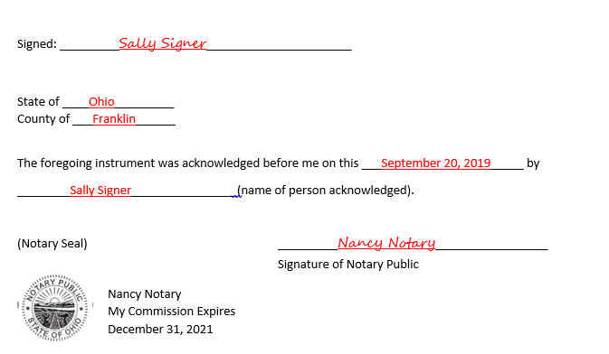
Acknowledgment Example

Slide 23
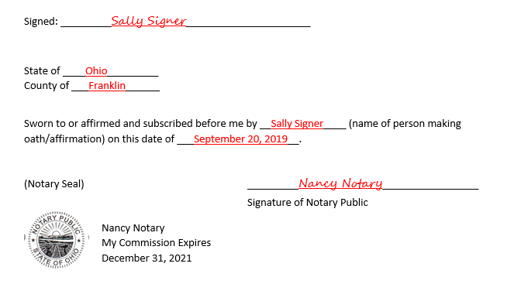
Jurat Example

Slide 24
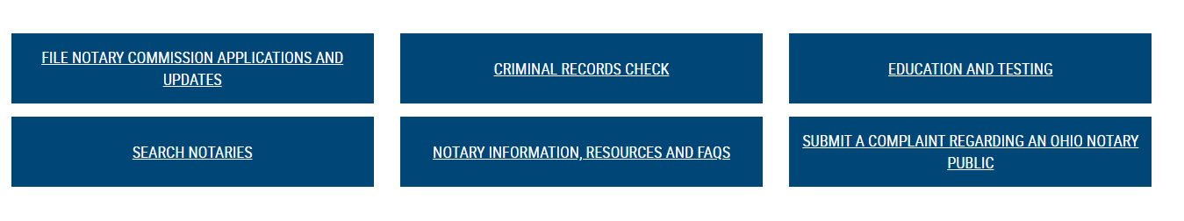
Notary Resources – ohiosos.gov/notary

Slide 25
Notary Advisory Board
Investigate notary complaints
Recommend discipline
Review and recommend legislative changes
Review and recommend procedural changes

Slide 26
Notarizations and COVID-19
Changes to make traditional in person notarizations safe for the notary public and the signer(s).
Executive Orders temporarily permitting other types of remote notarizations in other states.

Slide 27
Remote Ink-Signed Notarial Acts
What is Remote Ink-signed notarization?
  Remote Ink-signed notarizations (RIN) occur when the person signing the document and the notary do not have to be in the same place or connected on an online notarization system.
  The signer has the physical document, the notary examines the government-issued identification through audio- visual technology (Facetime, Zoom, Microsoft Teams, etc), a wet signature is used on the physical document and the notary witnesses the signing, the signer sends the document to the notary via US Mail or in-person drop off, and after reciept the notary affixes their seal and completes the notarial certificate.
  Some states are referring to this as Audio-Visual Notarizations and permitting the signer to fax or email the signed document to the notary.

Slide 28
Remote Ink-Signed Notarial Acts
Is it Legal in Ohio?
  No, some states without remote online notarization laws in place have permitted this by executive order during the pandemic. Unlike remote online notarizations, audio-visual notarization does not need to be fully digital and does not need to be done on a specific platform. This means a signer and notary could use FaceTime or Zoom to complete the act and then use electronic signatures on the document or scan and email the signed document. Ohio requires the use of an online notarization system.

Slide 29
Questions?
Allison DeSantis
Director of Business Services and
Deputy Assistant Secretary of State
adesantis@ohiosos.gov
General Notary Questions: notary@ohiosos.gov

